Slide 1
PC Hardware Advisor
Making all PC hardware accessible to everyone.
1,400+ YouTube videos | One conversation | Your perfect PC in minutes
1,400+ Videos
~33,000 Chunks
5 yrs → Last week

Slide 2
The Problem
How people currently find a PC:
The gap nobody fills
Buy a pre-built
▸ No tool asks for your needs and configures directly for the user.
▸ None chatbots are specialised in PC hardware knowledge especially.
▸ Timestamps point you to the exact moment in a video.
▸ Everyone still ends up doing the research themselves
Fast, but you lose control. Pay a premium. Get a more generic spec.
PCPartPicker
Great compatibility checker — but you still need to know what parts you want. Intimidating for beginners.
Ask ChatGPT
Returns a guide, a table, websites to visit. Useful for learning but doesn't configure your system. Multiple steps to go through, still on you.
PC hardware should be accessible to everyone — not just people who already know the parts.

Slide 3

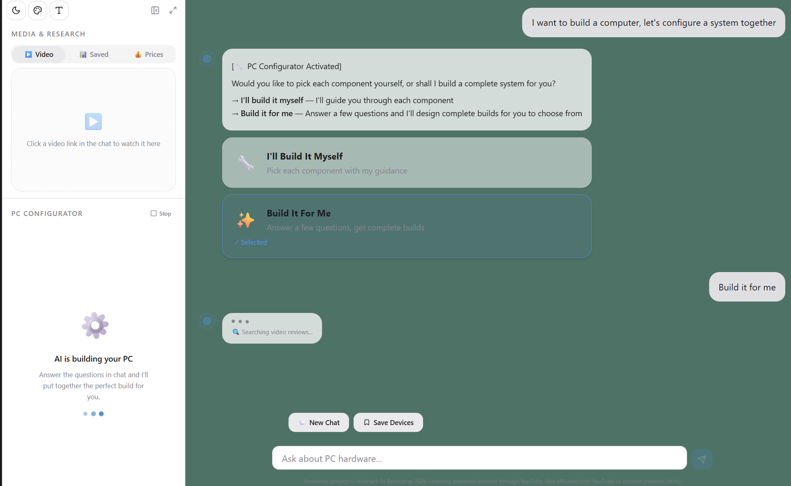



The Solution
PC Hardware Advisor
Making PC hardware accessible to everyone.
YouTube-Grounded Answers
Backed by 1,400+ videos from real reviewers, not hallucinated facts.
Clickable Timestamps
Skip straight to the moment that answers your question. No more scrubbing 25-min videos.
PC Configurator
9 questions → 1–4 complete builds with specs, metrics, pricing, and buy links.
Specialised, Not Generic
Unlike ChatGPT — it doesn't send you to research. It handles it for you, right now.

Slide 4
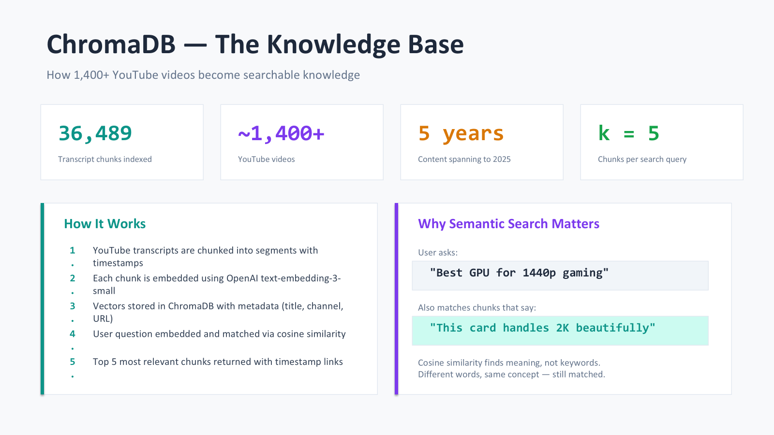

Slide 5
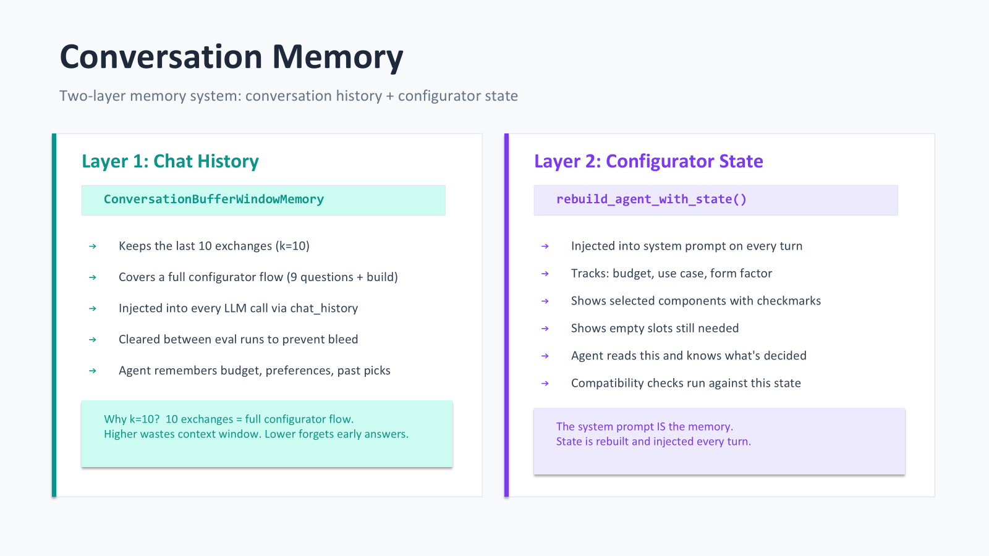

Slide 6
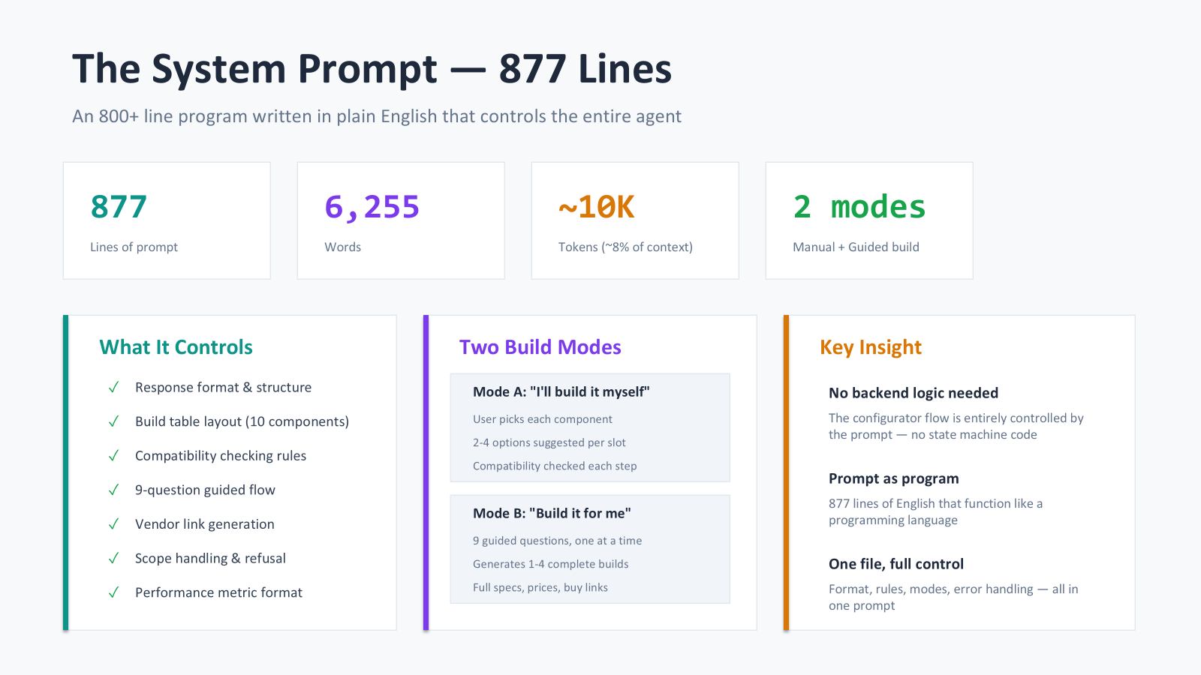

Slide 7
The PC Configurator
You start here. Not in a research spiral.
ChatGPT / Gemini — "Let's build a PC"
PC Hardware Advisor
1. Define the Purpose (Most Important)
2. Set a Budget
3. Choose the Platform (CPU + Motherboard)
4. Choose the Core Components
5. Check Compatibility
6. Assembly Order...
Useful for learning.
Still sends you to do the research.
No parts chosen for you.
▸ "Great choice! Let's get started."
▸ Q1: What's your budget?
▸ Q2: What will you use it for?
▸ ... 7 more targeted questions ...
▸ → 1–4 complete builds generated
▸ → Specs, metrics, pricing, buy links
▸ → Fully configured. Ready to order.
VS
⚡ The entire configurator flow > Two modes > 9 questions, Generate builds, compatibility — lives in the system prompt alone.

Slide 8
The Coding Journey
Three breakthroughs that shaped this project:
1
Force the Search
2
Prompt as State Machine
3
Chat as a UI
Without tool_choice="required" the agent answered from memory — and made up specs.
One line of code. Massive quality improvement.
The full configurator > Two Configuration modes, 9 questions, build format, compatibility rules > all lives in the system prompt.
Zero extra backend logic needed.
React parses hidden tags in the agent response to render build cards, images, sidebar state, and buy links.
The chat becomes a fully structured interface.

Slide 9
Evaluation
LangSmith EU • 25 curated test examples • 7 custom evaluators
Iterative Improvements
▸ Baseline recorded in LangSmith then every prompt change compared against it
▸ 10+ system prompt versions iterated
▸ Forced tool calling added → quality jump
▸ Variety rules, component detection, performance metrics all improved incrementally
Evaluator | Score | What it measures
configurator_mention | 1.00 ✅ | Triggers configurator appropriately
emulation_notice | 1.00 ✅ | Legal disclaimer for emulation queries
non_empty_response | 1.00 ✅ | Never returns a blank answer
scope_handling | 0.92 ✅ | Redirects out-of-scope gracefully
quality_score (LLM) | 0.83 ✅ | Overall quality, scored by GPT-4 judge
has_specs | 0.76 ⚠️ | Includes specs when discussing hardware
has_timestamps | 0.56 ⚠️ | Links to YouTube moments (excl. OOS queries)
Known Limitations
▸ has_timestamps at 0.56 — evaluator includes out-of-scope queries that don't need timestamps
▸ Latency +2–3s when SerpAPI web search is triggered
▸ More conversational warmth still to be added

Slide 10

Live Demo
Flow 1 — Build It For Me
Flow 2 — YouTube Learn
▸ Type: "I want a gaming PC for €1,200"
▸ 9 questions → configurator runs
▸ 2–3 complete builds side by side
▸ Pick one → direct buy links
▸ Ask: "What can you tell me about the latest MacBooks right now?”
▸ Click a timestamp → verify the source
▸ Ask follow-up — context is remembered
[ Screenshots below ]

Slide 11
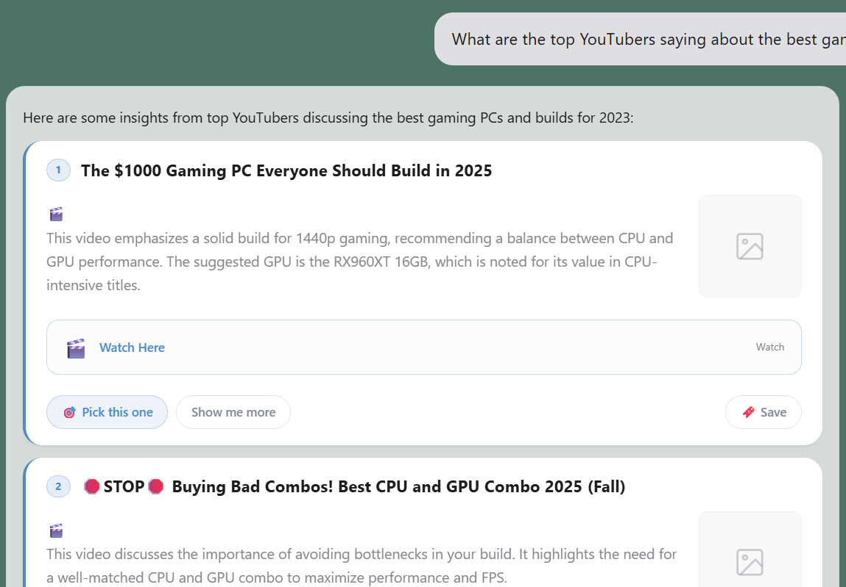
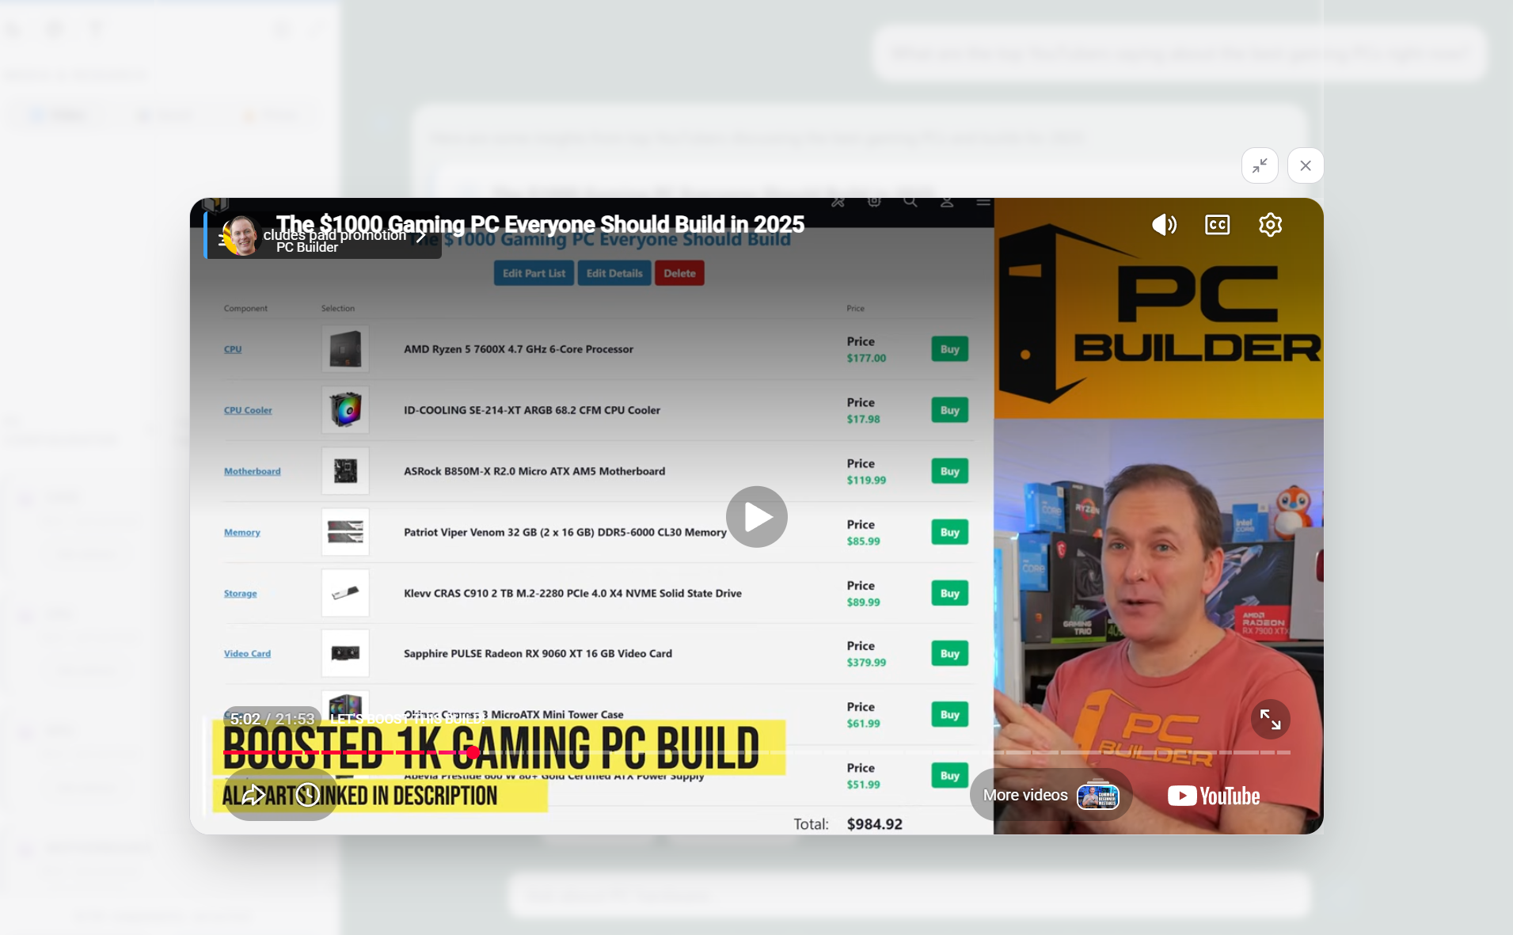
Learn Through Youtube Timestamps!

